Slide 1
PROMETHEUS SYSTEM

Slide 2

Project
Group Number -- 20
Mentors: Manish Rajahans
Notes:
Add instructor notes here.

Slide 3
Objectives
Abstract
Project Understanding
Approach used
Project Execution
Modules
Learning
Best Practices
Opportunity for improvement
Demo and Code Walkthrough
Q&A
Notes:
Add instructor notes here.

Slide 4
ABSTRACT
The goal of this project is to develop a system that addresses the problem described in the problem description, i.e. a system that helps teachers communicate homework to students and helps students to plan those homework assignments.
Prometheus allows to store, process, retrieve and analyse information with respective to the administrative and inventory management

Slide 5
Project Understanding
Prometheus is a system that can help teachers communicate homework to their students and that supports students in planning their homework. It is believed that the creation of this system is a solution to a problem that has been recognized in the education system.
Students seem to have problems planning their homework, especially at the University where there are few contact hours. This system can solve this problem by providing functionalities that support planning.
Notes:
Add instructor notes here.

Slide 6
Approach used :
SQL Server 2012: Database Layer.
NET Framework 4.5 + C# 5.0 :Developing Business components (C# classes).
WPF 4.5: Presentation Layer.
Notes:
Add instructor notes here.

Slide 7

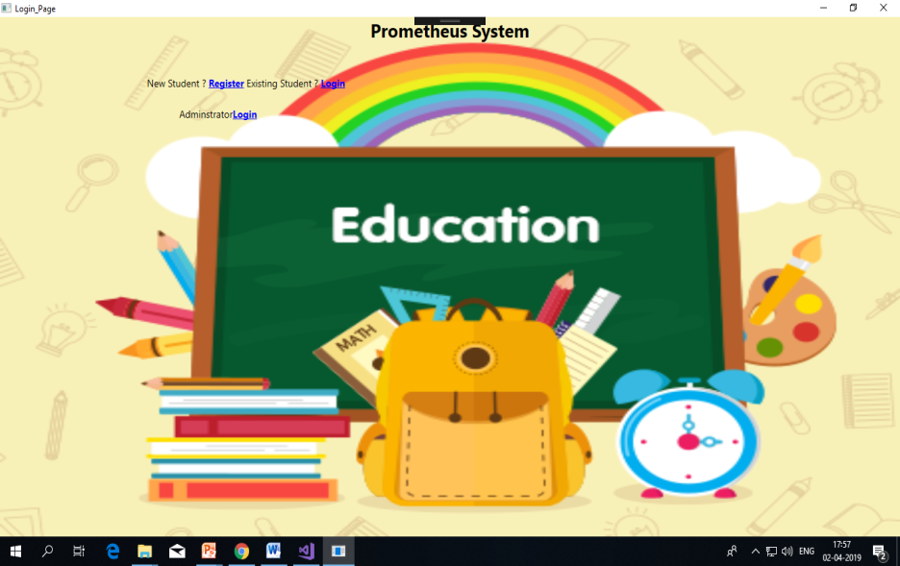
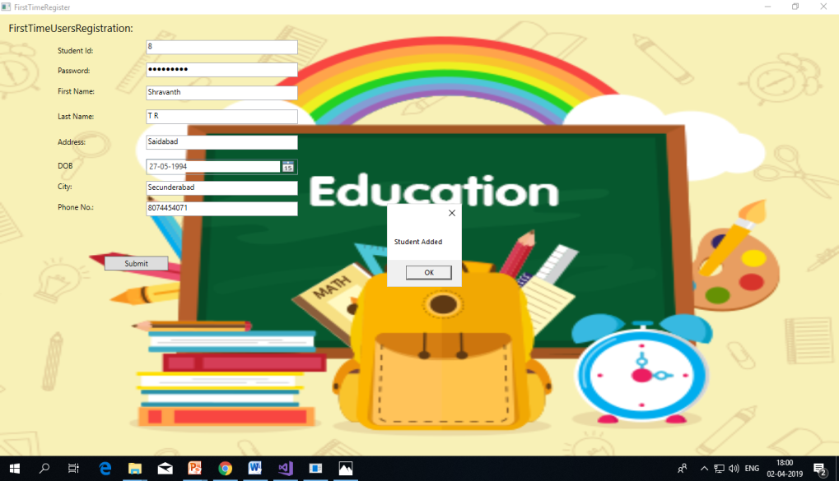
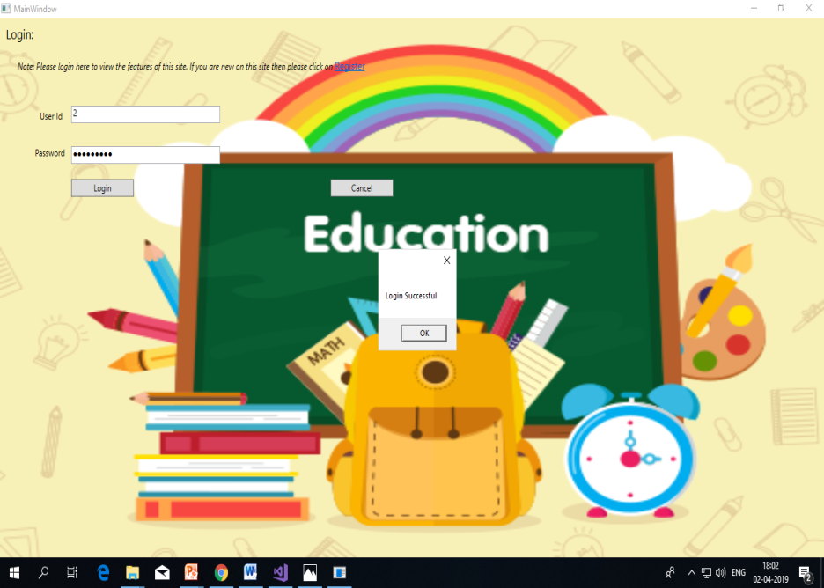
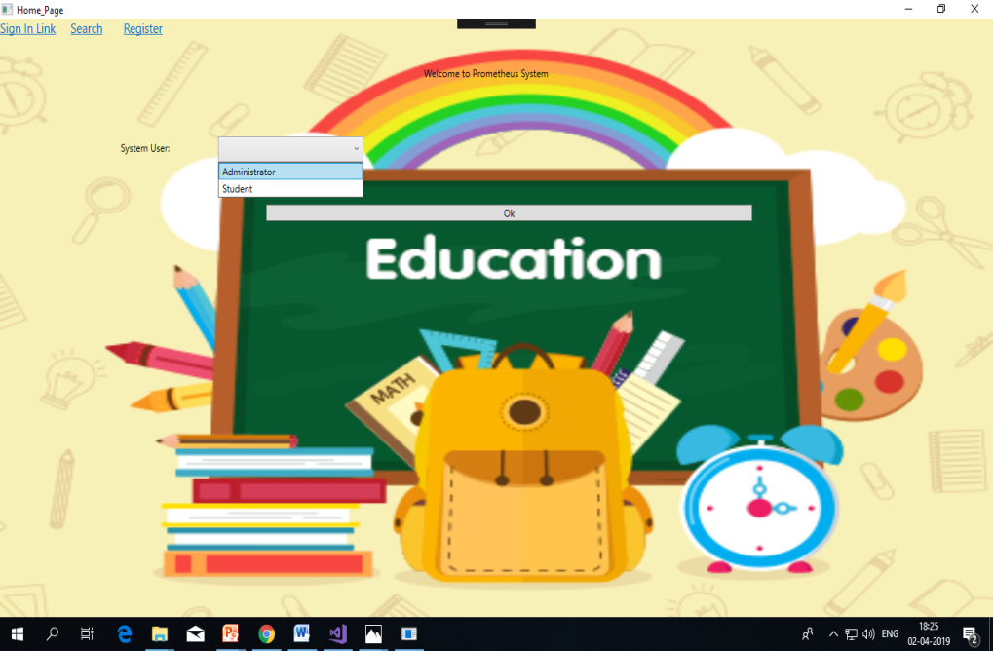
Project Execution
Notes:
Add the notes here.
Add instructor notes here.

Slide 8

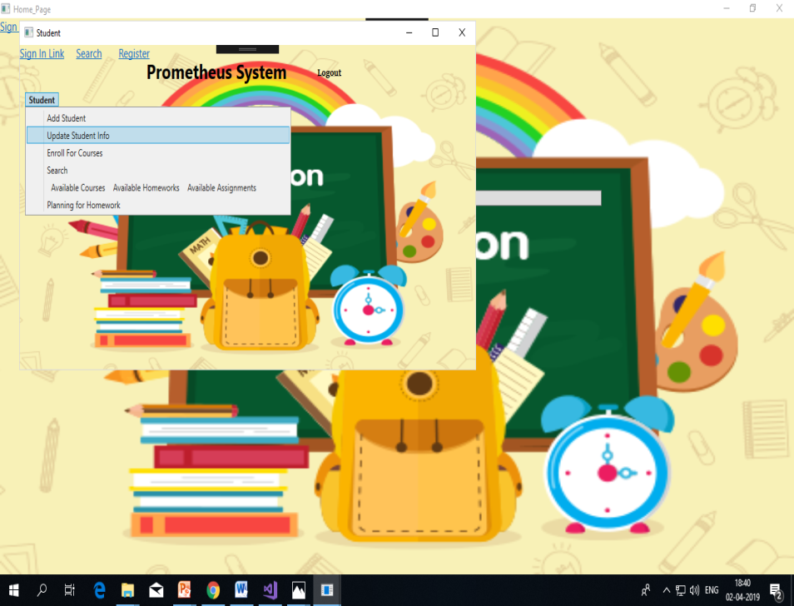
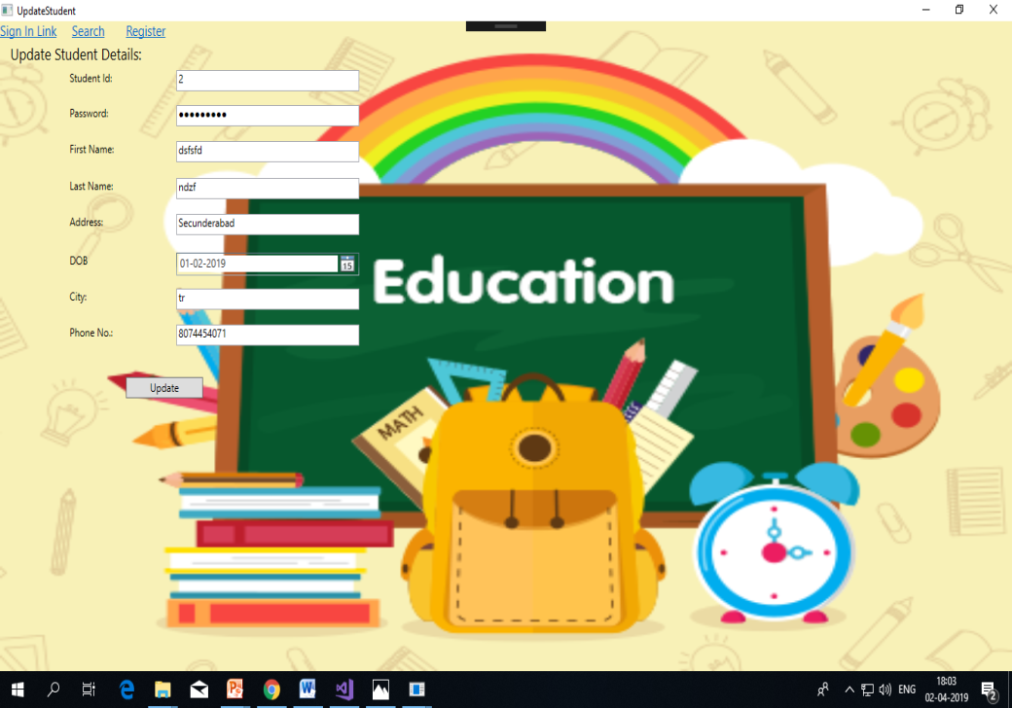
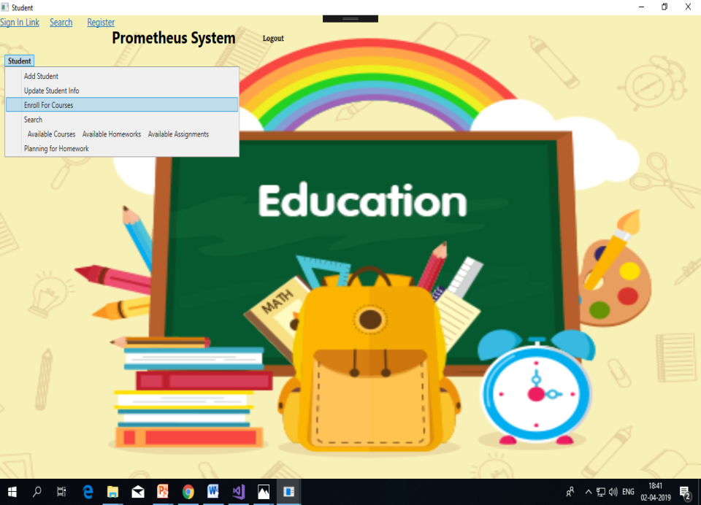
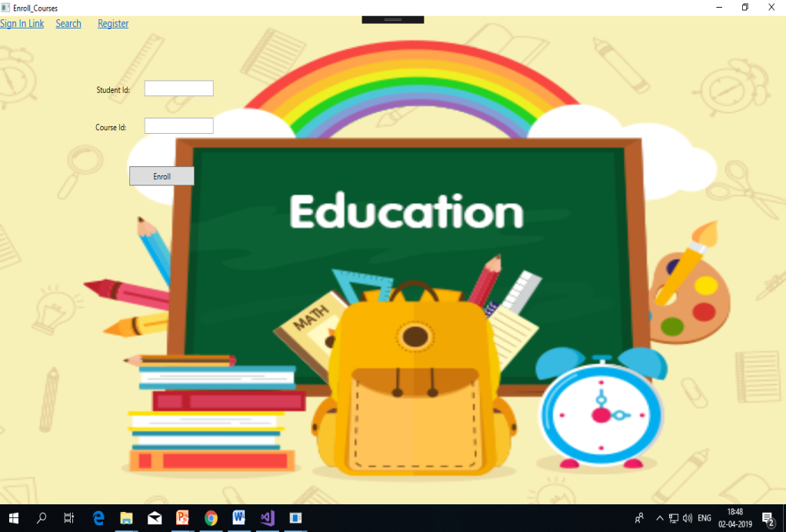

Slide 9
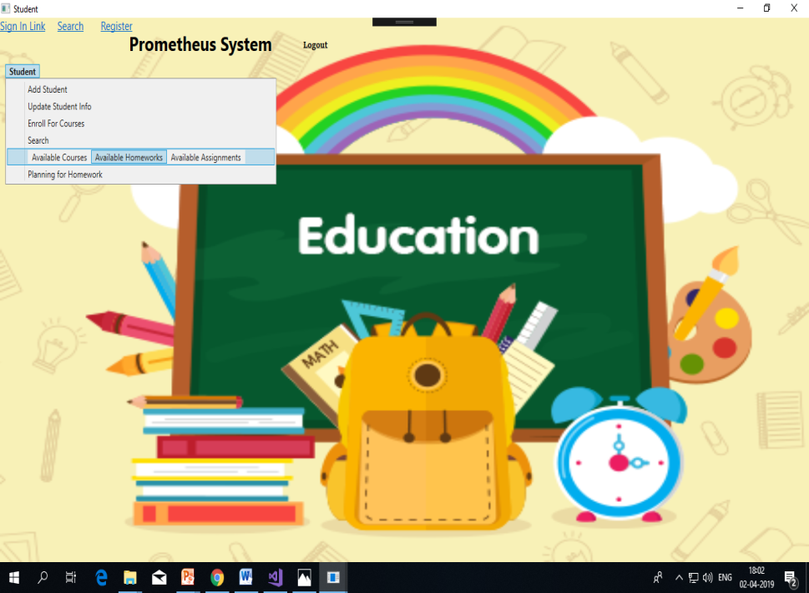
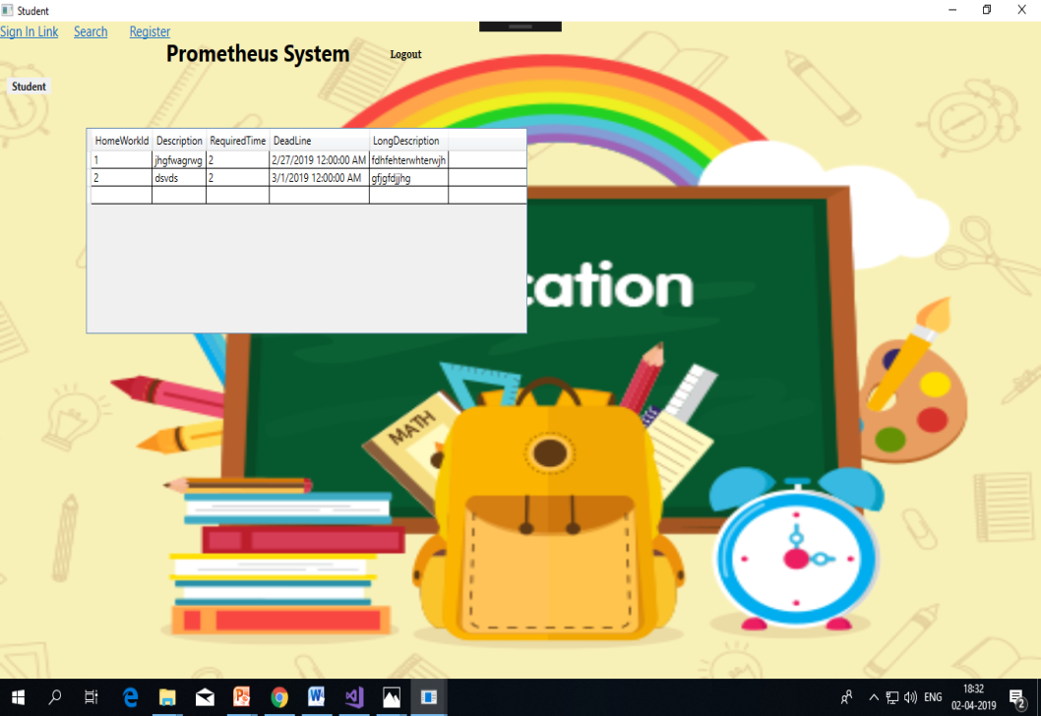

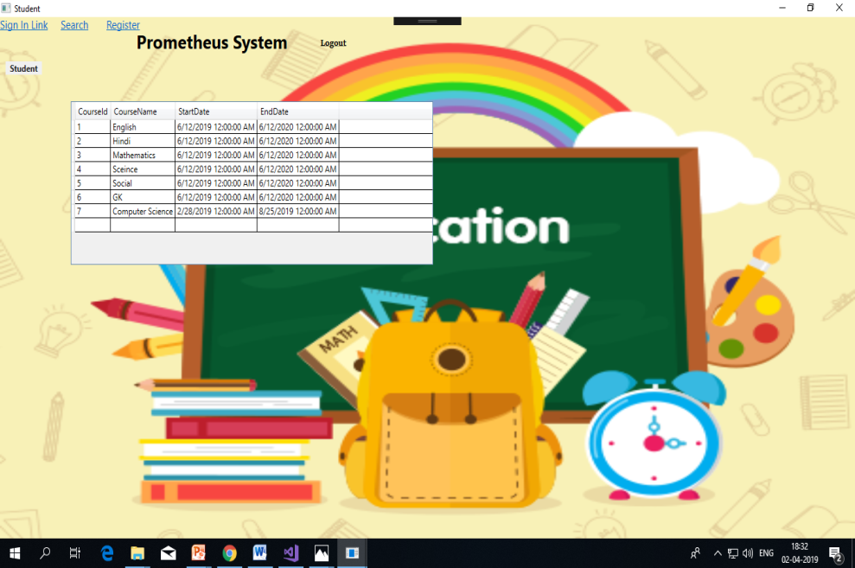

Slide 10

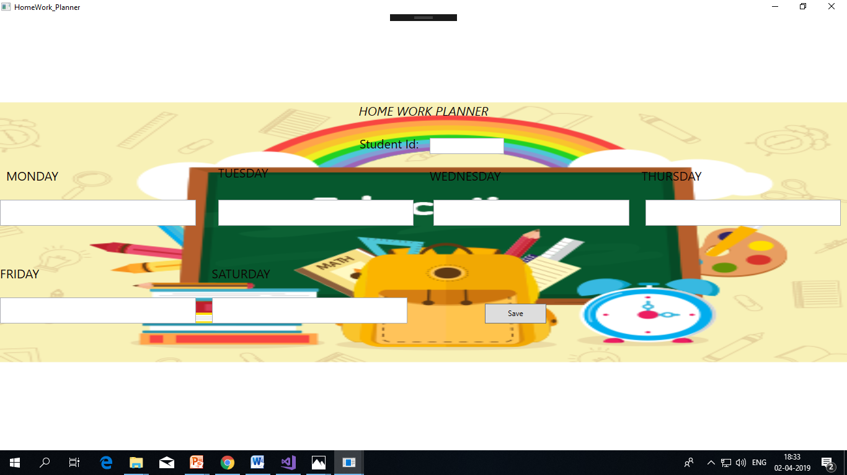

Slide 11
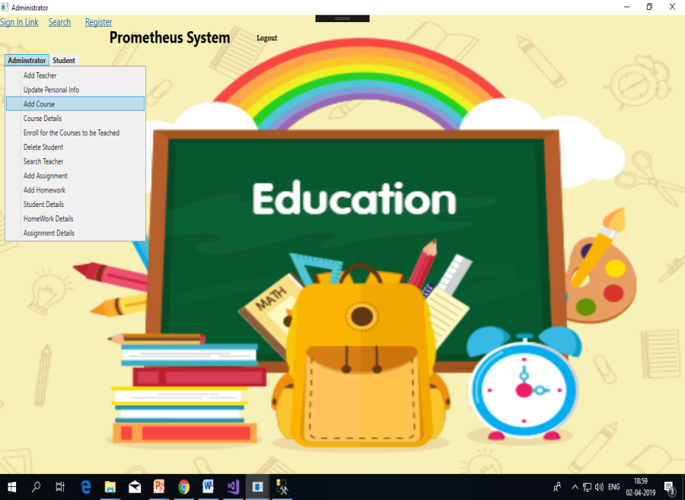
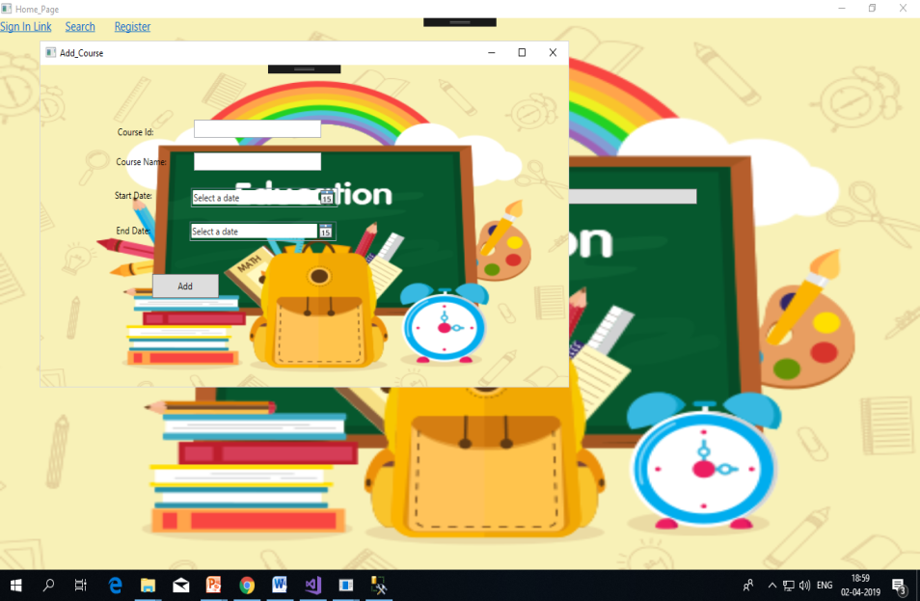
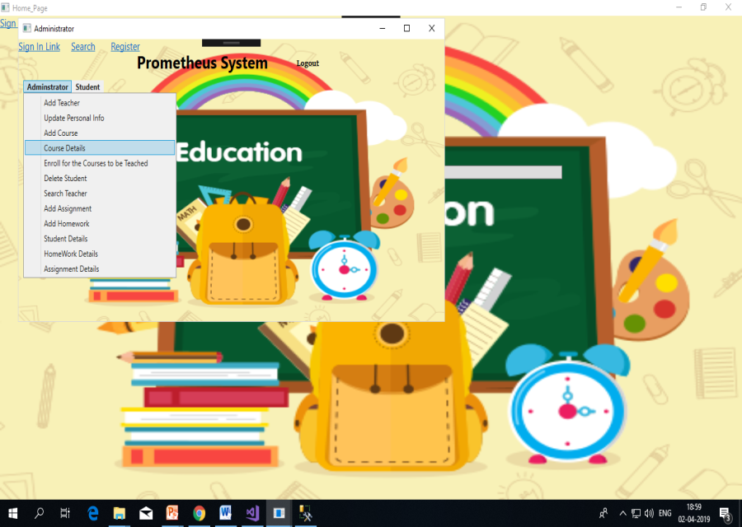
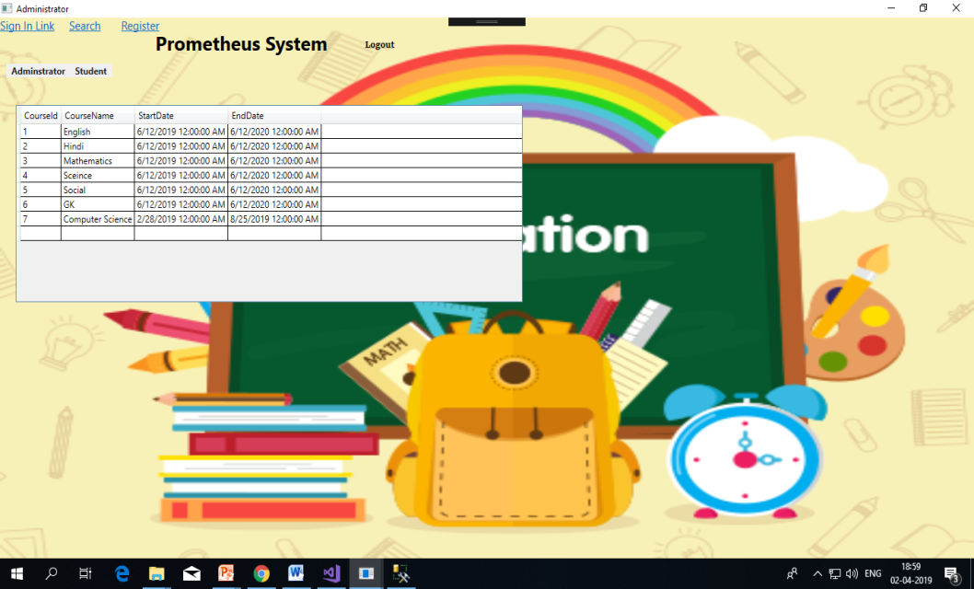

Slide 12
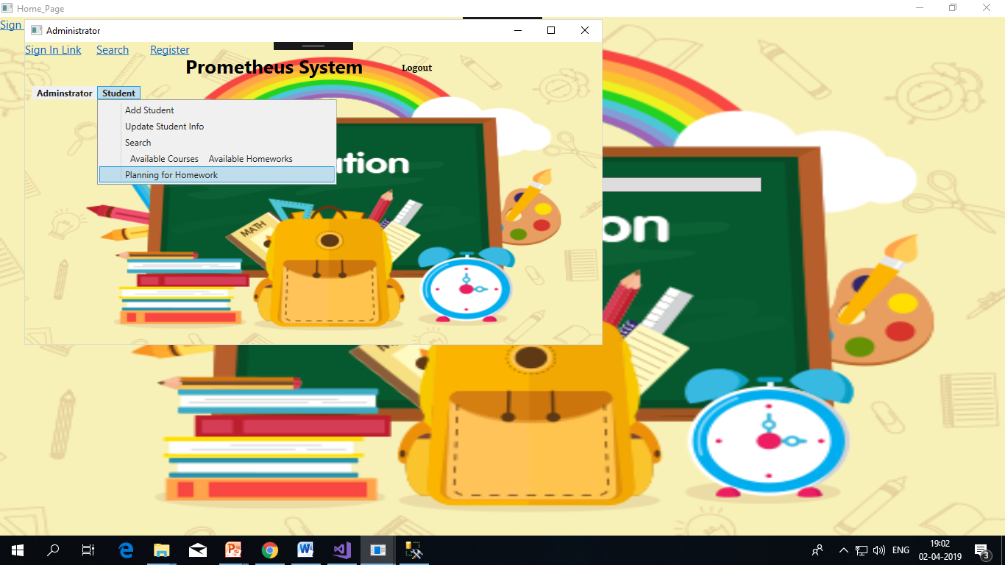
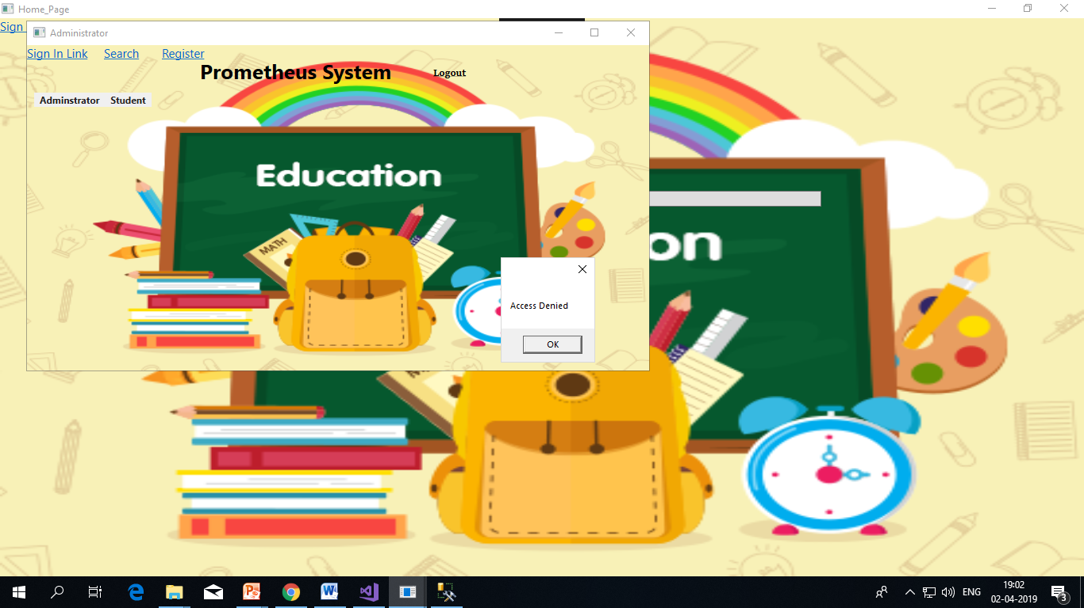

Slide 13
Modules
ADMINISTRATOR
Manage the application.
Can add Teachers, Students and courses to the system.
Can search Teachers, Students and courses to the system.
Can schedule homework assignments for the courses they teach
Can view all the homework assignments for their students
Teacher cant view the planning of the students
Notes:
Add instructor notes here.

Slide 14
Modules
STUDENT
Can enroll for Courses.
View their Homework.
Devise a planning for their Homework
Notes:
Add instructor notes here.

Slide 15
LEARNING
Here in this project we have used ADO.Net and WPF to build the solution.
In this we project we learnt about the role of admin and user.
To add styles and background images to the project WPF is used.
Learnt to connect database to the visual studio.
By using ADO.Net connected architecture we performed CRUD operations in data access layer.
Validation are given in business logic layer to validate the required fields.
Notes:
Add instructor notes here.

Slide 16
OPPORTUNITY FOR IMPROVEMENT
Some of the improvements are:
Making Homework Planning Simple and transparent.
Improving the Interaction between Teacher and Student.
Notes:
Add instructor notes here.

Slide 17
BEST PRACTICES
In this project I have used Layered architecture to build the solution.
In entity layer we need to give the variables.
In exception exception layer handles the exceptions occurred in the application.
In Data access layer all the CRUD operations are done.
In Business access layer all the validations were performed.
Naming conventions were given right and are understandable so there are no mistakes in the naming.

Slide 18
Thank You

